Slide 1
Recent advances in Pharma, Diagnosis and Endoscopy in Gastroenterology

Slide 2
Introduction
Gastroenterology has evolved rapidly, with continuous advancements in diagnostic and therapeutic approaches replacing older practices.
Modern gastroenterology integrates advanced diagnostic tools, therapeutic endoscopy, and pharmacological innovations
The integration of artificial intelligence and precision medicine is transforming gastroenterology by enabling more accurate diagnosis, improved decision-making, and personalized patient care.
Gangwani MK, Priyanka F, Irfan O, Hasan F, Gilani J, Sadiq MW, Pinnam BS, Ali H, Dahiya DS, Hayat U, Kamal F. Translational Gastroenterology and Hepatology. 2026 Jan 30;11.
Xu J, Tang X. Frontiers in Medicine. 2025 Jul 4;12:1647463.

Slide 3
Clinical need for Advancements
Conditions such as colorectal cancer, inflammatory bowel disease (IBD), and gastroesophageal reflux disease (GERD) are increasingly prevalent worldwide.
Delayed diagnosis: Advanced-stage presentation and poor clinical outcomes.
There is a growing need for minimally invasive, accurate, and cost-effective diagnostic and therapeutic strategies
Advances in pharmacotherapy, endoscopy, and artificial intelligence aim to address these challenges
Gangwani MK, Priyanka F, Irfan O, Hasan F, Gilani J, Sadiq MW, Pinnam BS, Ali H, Dahiya DS, Hayat U, Kamal F. Translational Gastroenterology and Hepatology. 2026 Jan 30;11.
Xu J, Tang X. Frontiers in Medicine. 2025 Jul 4;12:1647463.

Slide 4
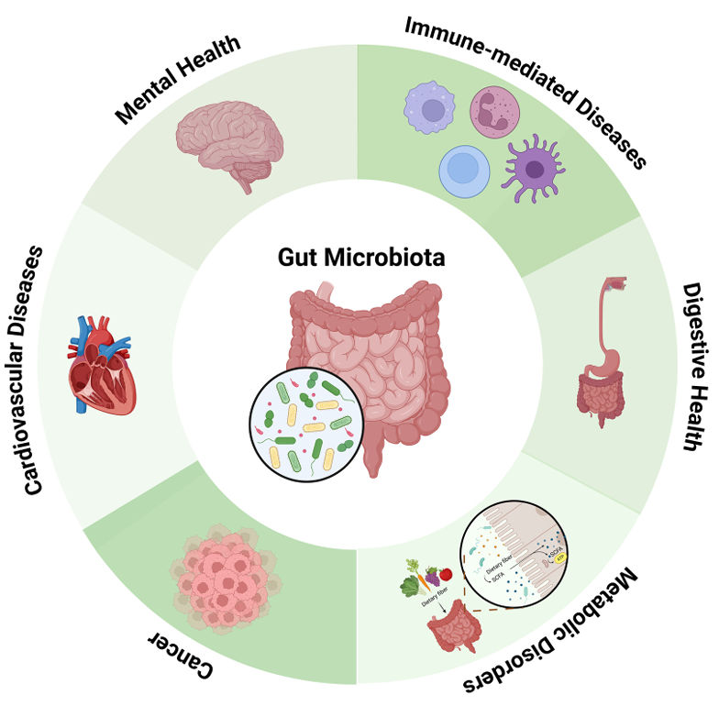
Overview of Recent Advances
Pharmacological advances: Biologics, immunomodulators, microbiome therapeutics and antiviral agents.
Diagnostic advancements: High-definition endoscopy, biomarkers chromoendoscopy, and non-invasive imaging techniques.
Endoscopic innovations: Endoscopic mucosal resection (EMR), endoscopic submucosal dissection (ESD), capsule endoscopy, peroral endoscopic myotomy (POEM) etc.
Yaqub MO, Jain A, Joseph CE, Edison LK. Gastrointestinal Disorders. 2025 Jan 15;7(1):7.
Diong S, Harewood G, Cheriyan D, et al. How rapidly gastroenterology has evolved over time: a review of four decades of published research. Ir Med J. 2022;115(6):618
Sinonquel P, Vermeire S, Maes F, Bisschops R. GE-Portuguese Journal of Gastroenterology. 2023 Jun 6;30(3):175-91.

Slide 5
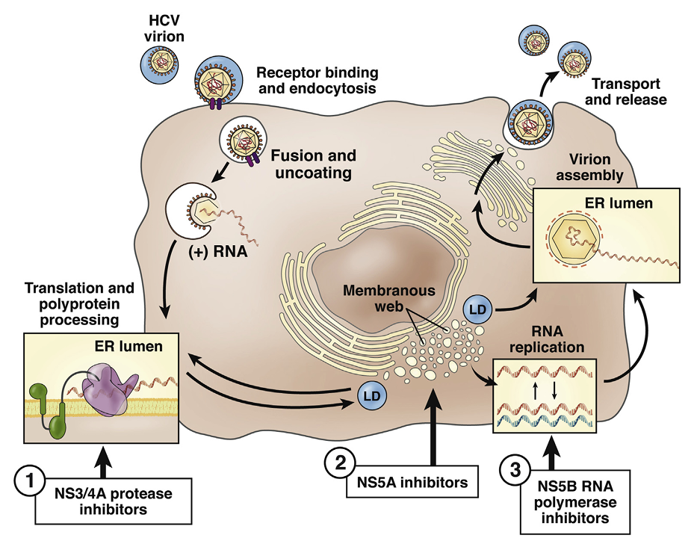
Recent Advances of Pharmacotherapy
Biologics: Anti‑TNF agents, anti‑integrins, and anti‑interleukin drugs
Direct‑acting antiviral (DAA) agents has transformed hepatitis C with short treatment durations and high success rates.
Precision medicine: Tailor drug therapy based on genetic, molecular, and clinical profiles of patients.
Emerging small‑molecule drugs: Janus kinase (JAK) inhibitors offer new oral treatment options.
Therapeutic targets of the HCV replication cycle. DAA viral target sites in advanced clinical development are numbered 1–3. ER, endoplasmic reticulum; LD, luminal domain.
Schmidt WN, Nelson DR, Pawlotsky JM, Sherman KE, Thomas DL, Chung RT. Clinical gastroenterology and hepatology. 2014 May 1;12(5):728-37.
Gangwani MK, Priyanka F, Irfan O, Hasan F, Gilani J, Sadiq MW, Pinnam BS, Ali H, Dahiya DS, Hayat U, Kamal F. Translational Gastroenterology and Hepatology. 2026 Jan 30;11.

Slide 6
Novel Biologics & Small Molecules in IBD
Drug Class
Agent
Mechanism
Clinical Outcome
IL-12/23 inhibitor
Mirikizumab
Anti-IL-23p19 mAb
LUCENT-2: 36.6% clinical remission at 52w in UC (vs 18.2% PBO)
IL-23 inhibitor
Risankizumab
Anti-IL-23p19 mAb
MOTIVATE/ADVANCE: 45% endoscopic remission in CD at 52w vs 13% PBO
Selective JAK1i
Upadacitinib
JAK1 selective inhibitor
U-ACHIEVE: 26.1% histologic remission in UC; fastest onset of any approved agent at 2 weeks
TYK2 inhibitor
Deucravacitinib
Allosteric TYK2 blockade
LATTICE-UC: Phase 2 remission 34.9% vs 7.7% PBO; oral, no JAK class warnings
Gut-selective JAKi
Izencitinib (TD-1473)
Pan-JAK, gut-restricted
Phase 2 complete; systemic exposure <1% of oral dose; reduced toxicity profile
D'Haens G. NEJM 2023;Ferrante M. Lancet 2022;Danese S. Lancet 2022; Sandborn WJ. Gastroenterology 2023; Parsons ME. CGH 2023

Slide 7
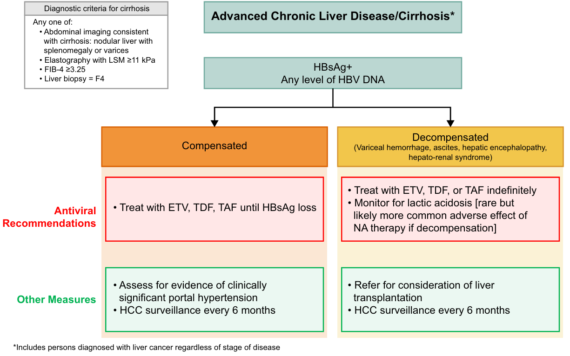
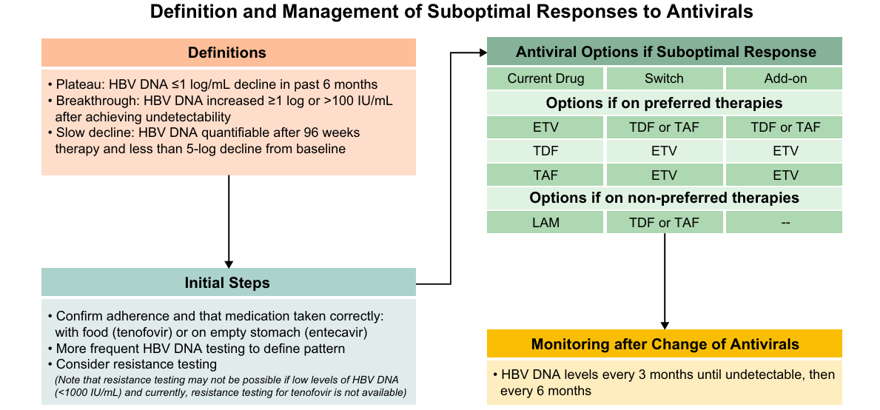
Advances in Hepatitis and Liver Disease
Direct‑acting antiviral (DAA) therapies have revolutionized the treatment of hepatitis C
These agents achieve sustained virological response (cure) rates exceeding 95%, making hepatitis C a curable disease in most patients.
In chronic hepatitis B, nucleos(t)ide analogues such as tenofovir and entecavir effectively suppress viral replication and reduce disease progression.
Abbreviations: ETV, entecavir; LAM, lamivudine; TDF, tenofovir disoproxil fumarate; TAF, tenofovir alafenamide; HBsAg, hepatitis B surface antigen; HCC, hepatocellular carcinoma; LSM, liver stiffness measure; NA, nucleos/tide analogue.
Notes:
Ghany MG, Pan CQ, Lok AS, Feld JJ, Lim JK, Wang SH, Kim AY, Tang AS, Nguyen MH, Naggie S, Sulkowski MS. AASLD IDSA Practice Guideline on treatment of chronic hepatitis B. Hepatology. 2026 Apr 1;83(4):974-97
Marshall AD, Willing AR, Kairouz A, Cunningham EB, Wheeler A, O’Brien N, Perera V, Ward JW, Hiebert L, Degenhardt L, Hajarizadeh B. Direct-acting antiviral therapies for hepatitis C infection: global registration, reimbursement, and restrictions. The Lancet Gastroenterology & Hepatology. 2024 Apr 1;9(4):366-82.
Apol ÁD, Sølund C, Vinten C, Underwood AP, Bukh J, Weis N. Cure of chronic hepatitis C virus infection after DAA treatment only partially restores the functional capacity of exhausted T cell subsets: A systematic review. Frontiers in Immunology. 2025 Sep 1;16:1546915.

Slide 8
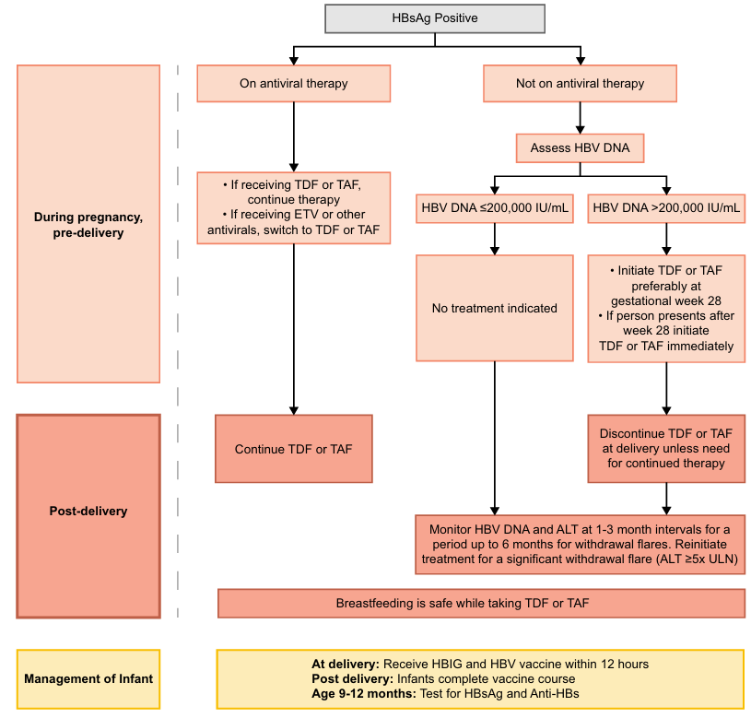
Management Algorithm for Hepatitis B in Pregnancy
Abbreviations: CHB, chronic hepatitis B; ETV, Entecavir; HBIG, hepatitis B immunoglobulin; HBsAg, hepatitis B surface antigen; MTCT, mother-to child transmission; TDF, tenofovir disoproxil fumarate; TAF, tenofovir alafenamide; ULN, upper limit of normal.
Ghany MG, Pan CQ, Lok AS, Feld JJ, Lim JK, Wang SH, Kim AY, Tang AS, Nguyen MH, Naggie S, Sulkowski MS. Hepatology. 2026 Apr 1;83(4):974-97.

Slide 9
Emerging Pharmacotherapy in MASLD
Resmetirom (MGL-3196)
MAESTRO-NASH: NASH resolution 26% vs 10% PBO; fibrosis improvement ≥1 stage 24% vs 14% (P<0.001). FDA-approved March 2024 (Rezdiffra) — FIRST approved MASH therapy.
THR-β agonist
Semaglutide 2.4 mg
ESSENCE trial (Phase 3): NASH resolution 62.9% vs 34.3% PBO; fibrosis ≥1 stage regression 36.5% vs 22.4%. Concurrent weight loss.
GLP-1 receptor agonist
Lanifibranor
NATIVE trial: 49% NASH resolution + fibrosis improvement vs 22% PBO; HDL +38%, TG −31%. Phase 3 NATIVELAB ongoing.
Pan-PPAR agonist (α/δ/γ)
Efruxifermin
HARMONY trial: 41% fibrosis regression (F2/F3) at 24w vs 20% PBO; safe in decompensated cirrhosis cohort. AST/ALT normalized in 68%.
FGF21 analogue
Obeticholic Acid
REGENERATE (48-month): fibrosis improvement 23% (25mg) vs 12% PBO. Pruritus limits adherence (51%). Awaits full FDA approval for cirrhosis indication.
FXR agonist
Harrison SA. NEJM 2024; Newsome PN. NEJM 2024; Francque SM. NEJM 2021; Loomba R. Lancet 2023; Younossi ZM. Lancet 2023

Slide 10
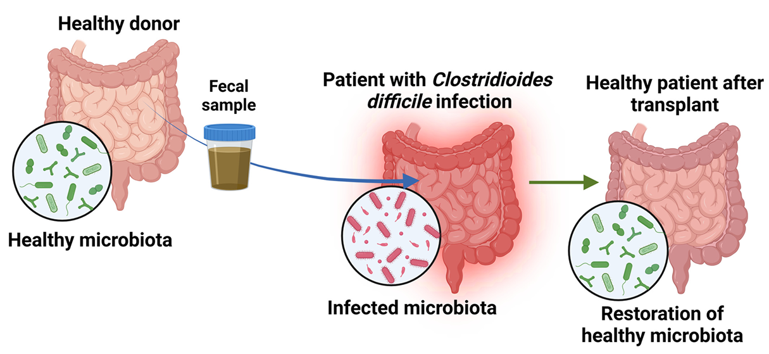
Future Trend in Pharmacotherapy
Microbiome‑Based Therapies: Faecal microbiota transplantation (FMT) has emerged as a microbiome‑based therapy that restores gut microbial balance and is established for recurrent Clostridioides difficile infection.
Gene Therapy & Precision Medicine: CRISPR‑based genome editing is being explored for treating liver diseases
AI + Multi‑Omics Precision Medicine: Artificial intelligence is increasingly used to analyse complex data and guide therapeutic decision‑making.
Yaqub MO, Jain A, Joseph CE, Edison LK. Gastrointestinal Disorders. 2025 Jan 15;7(1):7.
Zabaleta N, Unzu C, Weber ND, Gonzalez-Aseguinolaza G. Reviews Gastroenterology & Hepatology. 2023 May;20(5):288-305.

Slide 11
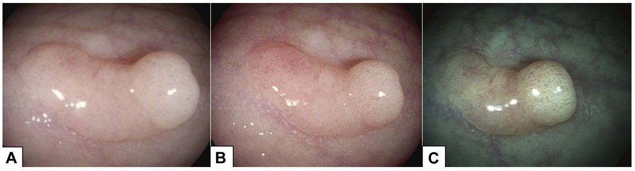
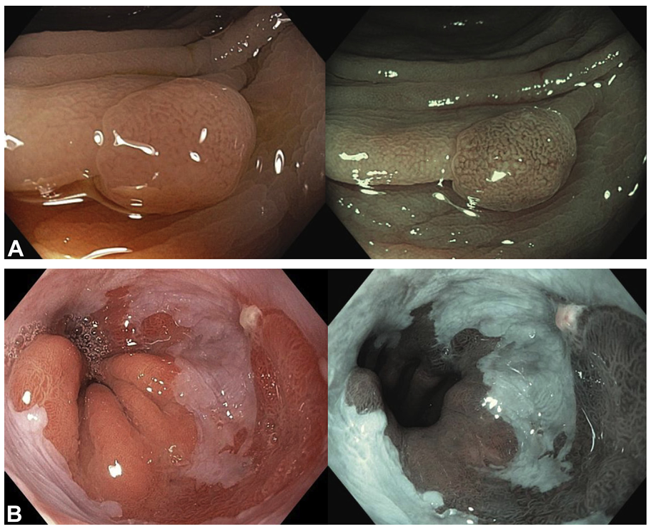
Advanced Endoscopic Imaging
High-definition white-light endoscopy image (A) of a tubular adenoma and the corresponding i-SCAN surface enhancement (i-SCAN 1) (B), i-SCAN tone enhancement (i-SCAN 2) (C) of the same polyp.
High‑definition (HD) endoscopy provides superior image resolution, allowing better visualization.
Virtual chromoendoscopy techniques: Narrow‑band imaging (NBI) and i‑SCAN improve visualization of vascular and mucosal patterns without the need for dyes.
These imaging techniques help in the early detection of dysplasia and neoplasia such as Barrett’s oesophagus and colorectal cancer.
Chromoendoscopy enhances lesion detection by using dyes or digital imaging techniques.
A, White-light imaging versus corresponding narrow-band imaging (NBI) of a colonic adenoma; capillaries appear brown, whereas deeper vessels appear cyan. B, White-light imaging versus corresponding NBI of the Barrett’s oesophagus.
Manfredi MA, Dayyeh BK, Bhat YM, Chauhan SS, Gottlieb KT, Hwang JH, Komanduri S, Konda V, Lo SK, Maple JT, Murad FM. Gastrointestinal endoscopy. 2015 Feb 1;81(2):249-61.
Sinonquel P, Vermeire S, Maes F, Bisschops R. GE-Portuguese Journal of Gastroenterology. 2023 Jun 6;30(3):175-91.

Slide 12
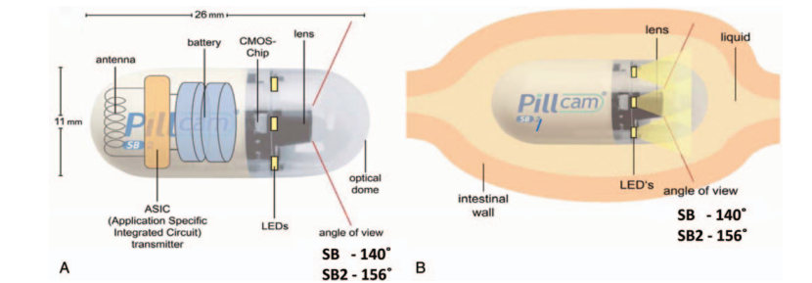
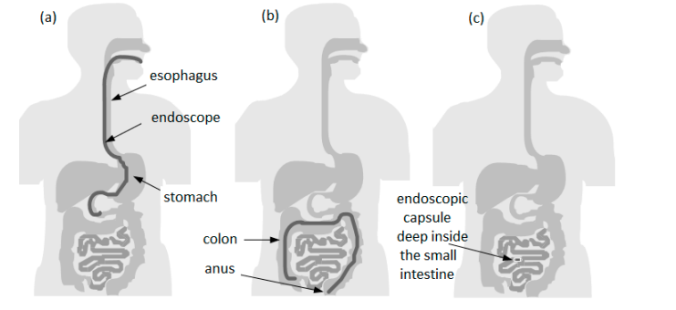
Capsule Endoscopy
Non‑invasive diagnostic technique that uses a swallowable wireless camera to visualize the gastrointestinal tract.
Allows complete visualization of the small intestine
Particularly useful in the evaluation of obscure gastrointestinal bleeding, small bowel tumours, and Crohn’s disease.
Improves patient comfort and avoids the need for sedation or hospital admission.
A) Schematic structure of the capsule (B) capsule endoscopy in the small bowel.
Flemming J, Cameron S. Medicine. 2018 Apr 1;97(14):e0148.
Gounella R, Granado TC, Hideo Ando Junior O, Luporini DL, Gazziro M, Carmo JP. Bioengineering. 2023 Nov 23;10(12):1347.
( a) upper endoscopy (b) lower endoscopy; (c) area that cannot be reached by conventional upper endoscopy or even by colonoscopy

Slide 13
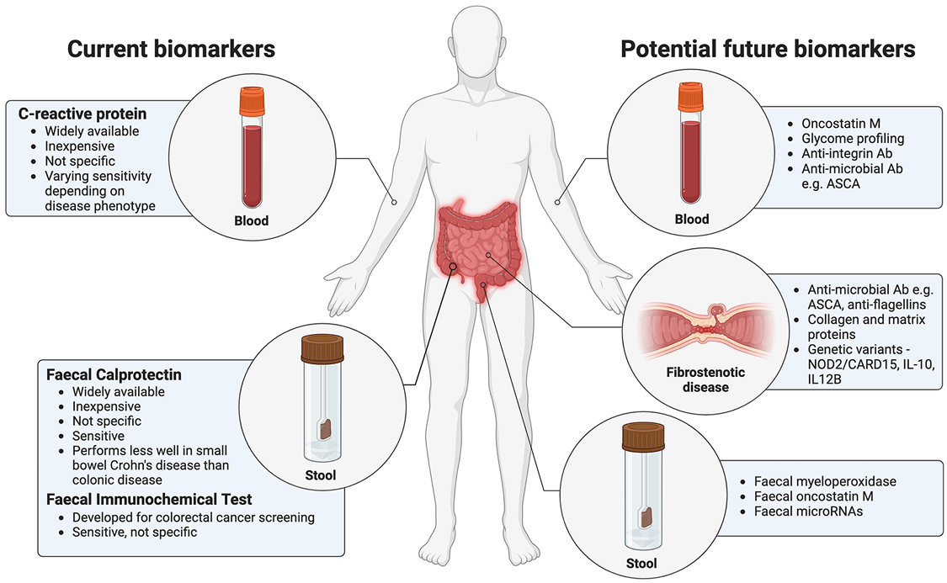
Biomarkers for Diagnosis
Measurable biological indicators that help in the diagnosis, prognosis, and monitoring of gastrointestinal diseases.
Non‑invasive or minimally invasive alternative to endoscopy
In colorectal cancer, stool‑ and blood‑based biomarkers enable non‑invasive screening and early detection of disease.
Future biomarker research focuses on multi‑omics and personalized diagnostics to guide targeted therapies and reduce reliance on invasive endoscopy.
Mukherji R, Yin C, Hameed R, Alqahtani AZ, Kulasekaran M, He AR, Weinberg BA, Marshall JL, Hartley ML, Noel MS. Biology Direct. 2022 Jun 6;17(1):15.
Clough J, Colwill M, Poullis A, Pollok R, Patel K, Honap S. Therapeutic advances in gastroenterology. 2024 May;17:17562848241251600.

Slide 14
Liquid Biopsy in GI Oncology: ctDNA & Multi-Cancer Detection
Guardant Shield (CRC)
Galleri (GRAIL) Multi-Cancer
83.1% sensitivity, 89.6% specificity
91.7% cancer signal origin accuracy
Methylation + somatic mutation panel from cell-free DNA; FDA-approved June 2024 as first blood-based CRC screening test (MCED-SHIELD trial, N=7861).
Methylation-based cfDNA detects >50 cancer types; sensitivity 51.5% across all stages (Stage I: 16.8%; Stage III: 67.6%). PPV 43.1% (PATHFINDER study).
ctDNA for MRD Monitoring
cfRNA in Pancreatic Cancer
96% NPV for recurrence
90% sensitivity (Stage I/II PDAC)
Post-resection ctDNA clearance (signatera assay) predicts disease-free survival in CRC; ctDNA+ve patients had 8× higher recurrence risk (HR 8.3; 95% CI 5.2–13.2).
Plasma cfRNA panel (5-gene) detects early PDAC with AUC 0.97; complements CA 19-9 which lacks sensitivity for early-stage disease (sensitivity 55%).
Chung DC. NEJM 2024; Schrag D. NEJM 2023; Tie J. NEJM Evid 2022; Cohen JD. Science 2023

Slide 15
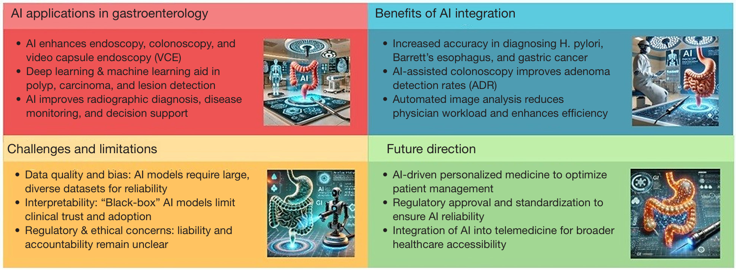
Role of AI
Transforming gastrointestinal diagnosis by improving the detection, characterization, and classification of lesions.
Machine learning and deep learning algorithms can analyse endoscopic images with high accuracy
AI‑assisted colonoscopy has been shown to improve adenoma detection rates
Enables real‑time decision support during endoscopy, improving diagnostic efficiency and reducing operator dependency.
Gangwani MK, Priyanka F, Irfan O, Hasan F, Gilani J, Sadiq MW, Pinnam BS, Ali H, Dahiya DS, Hayat U, Kamal F. Translational Gastroenterology and Hepatology. 2026 Jan 30;11.
Bencardino S, Lodola I, Centanni L, Mandarino FV, Fanizza J, Furfaro F, D’Amico F, Fuccio L, Bruni A, Facciorusso A, Massironi S. Frontiers in Medicine. 2025;12:1719145.

Slide 16
AI-Assisted Endoscopy :
In endoscopy, AI is utilized to enhance diagnostic accuracy and improve procedural efficiency
Applications of AI in Endoscopy:
Lesion Detection:
AI algorithms analyse endoscopic images in real-time to identify polyps, tumours, and other abnormalities
Studies show AI can significantly increase adenoma detection rates (ADR) during colonoscopy
Image Analysis:
AI systems can classify lesions based on characteristics, aiding in the differentiation between benign and malignant findings
Enhanced visualization techniques, such as narrow-band imaging, are often integrated with AI for better outcomes
Ref: Jiang K, Frontiers in Medicine. 2021 Mar 15;8:629080.

Slide 17
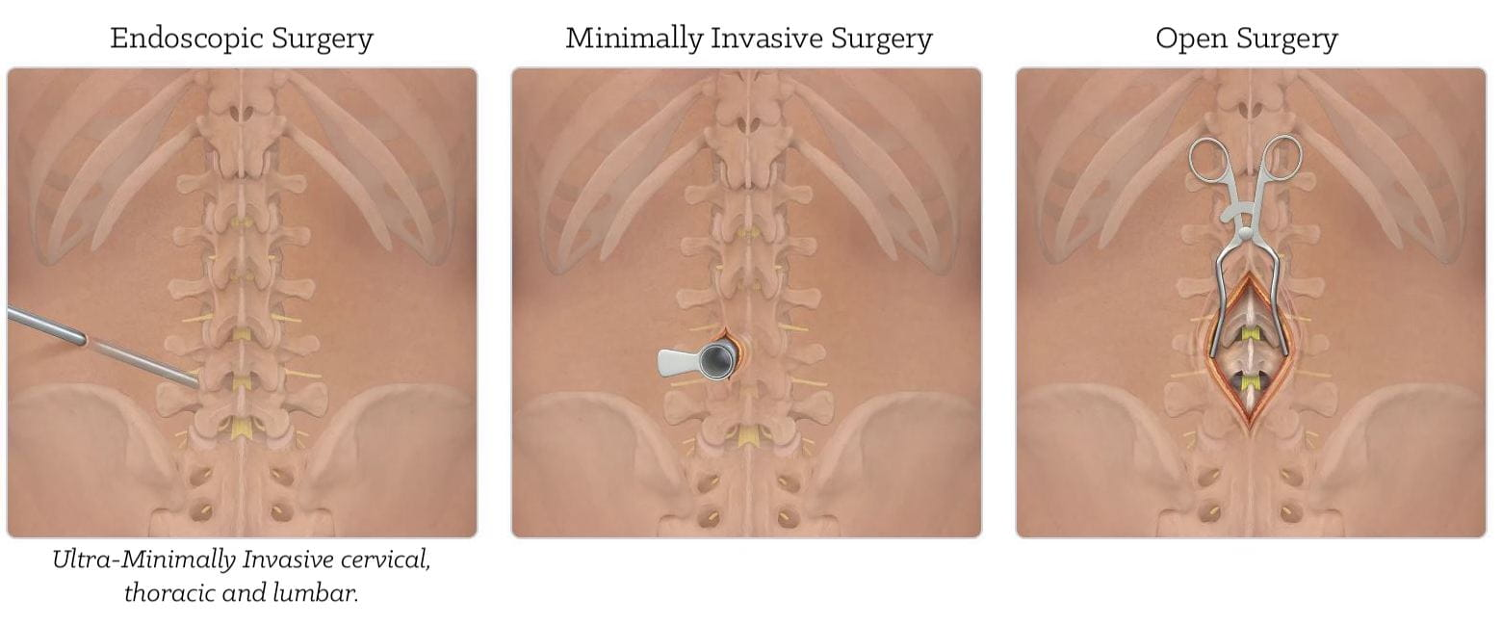
Advances in Therapeutic Endoscopy
Endoscopy has evolved from a primarily diagnostic tool to a major minimally invasive treatment modality in gastroenterology.
Allows effective management of various gastrointestinal conditions without the need for open surgery.
Modern therapeutic endoscopy includes techniques such as resection, suturing, stenting, and minimally invasive interventions for a wide range of gastrointestinal diseases.
Xu J, Tang X. Frontiers in Medicine. 2025 Jul 4;12:1647463.
Nabi Z, Reddy DN. Digestive and Liver Disease. 2024 Nov 1;56(11):1810-8.
Rudiman R. Annals of Medicine and Surgery. 2021 Nov 1;71:102922.

Slide 18
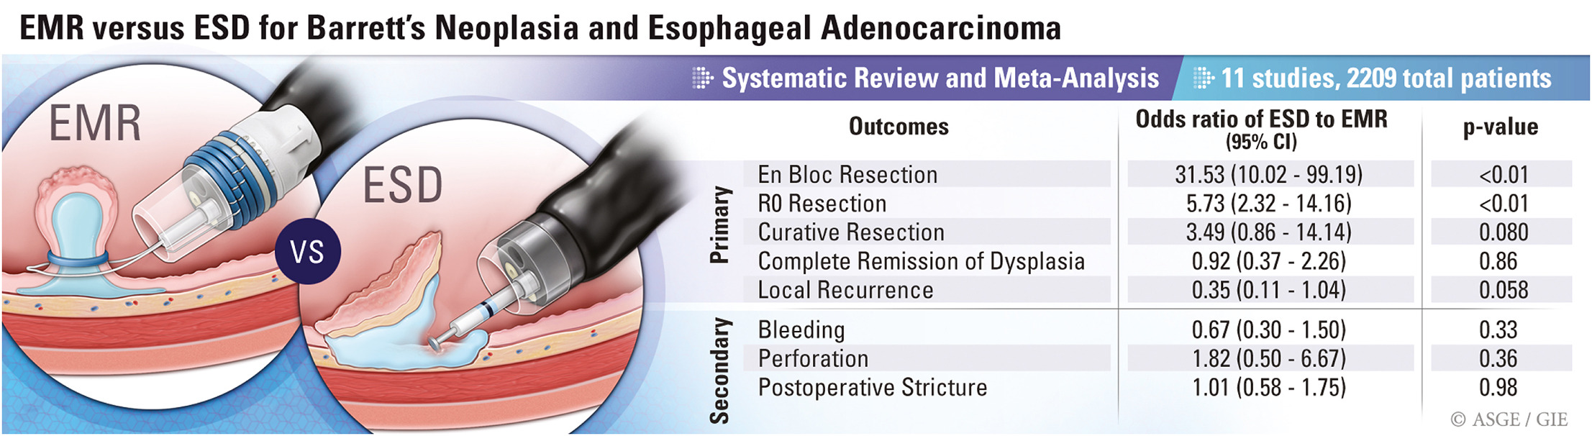
Endoscopic Resection Techniques: EMR & ESD
Endoscopic Mucosal Resection (EMR)
Technique used to remove superficial lesions confined to the mucosa using snaring methods.
Commonly used for the treatment of early gastrointestinal cancers and large polyps
Relatively simple, safe, and widely practiced
Endoscopic Submucosal Dissection (ESD)
Advanced technique that allows en‑bloc resection of larger and deeper lesions.
higher rates of complete (R0) resection and reduces recurrence compared to EMR.
technically more demanding and associated with longer procedure times and higher risk of complications.
Fujiyoshi Y, Khalaf K, He T, Tham D, Yuan Y, Calo NC, Grover SC, Teshima CW. Gastrointestinal Endoscopy. 2024 Nov 1;100(5):817-28.
Nabi Z, Reddy DN. Digestive and Liver Disease. 2024 Nov 1;56(11):1810-8.

Slide 19
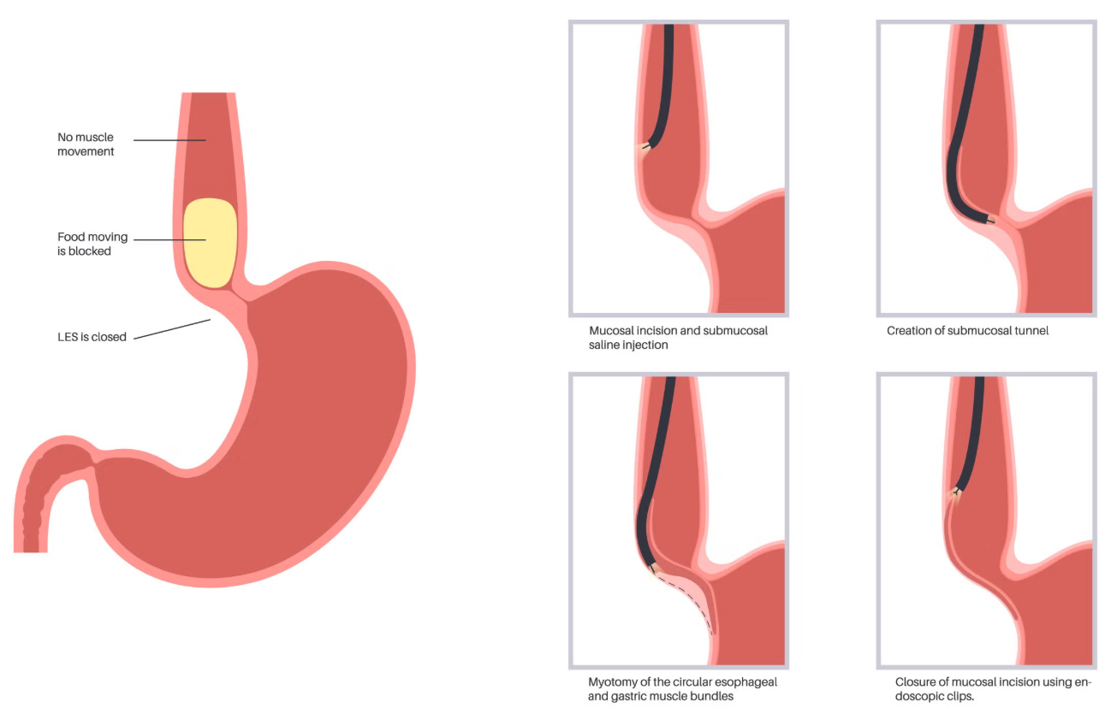
Peroral Endoscopic Myotomy (POEM)
Minimally invasive endoscopic procedure used for the treatment of achalasia and other oesophageal motility disorders.
Involves endoscopic division of the oesophageal muscle fibers through a submucosal tunnel
POEM offers high clinical success rates and avoids the need for invasive surgical myotomy.
Xu J, Tang X. Frontiers in Medicine. 2025 Jul 4;12:1647463.

Slide 20
ERCP Innovations: Digital Cholangioscopy & Lithotripsy
Digital Single-Operator Cholangioscopy (SOC)
SpyGlass DS II (Boston Scientific): 4-way tip deflection (270°), HD imaging 3× better resolution than prior generation. Diagnostic accuracy for indeterminate biliary stricture: sensitivity 95%, specificity 82% (DISCOVER study, N=481). AI-assisted SpyBite biopsy targeting improves tissue adequacy to 93.7%.
EHL & LL (Electrohydraulic/Laser Lithotripsy)
Holmium:YAG laser via cholangioscopy achieves single-session clearance of difficult bile duct stones in 89% of cases (vs 55% for ESWL). Pulsed-dye laser Vortex system reduces procedure time 45 → 28 min; complete clearance 92.4% in prospective multicenter series.
Confocal Laser Endomicroscopy (CLE) of Bile Duct
pCLE with nCLE criteria for cholangiocarcinoma: sensitivity 98%, specificity 67%, AUC 0.91 in meta-analysis (N=1,237). Real-time optical histology reduces need for repeat ERCP for tissue acquisition.
Navaneethan U. Am J Gastroenterol 2023; Buxbaum JL. Gastrointest Endosc 2024; Slivka A. Clin Gastroenterol Hepatol 2023

Slide 21
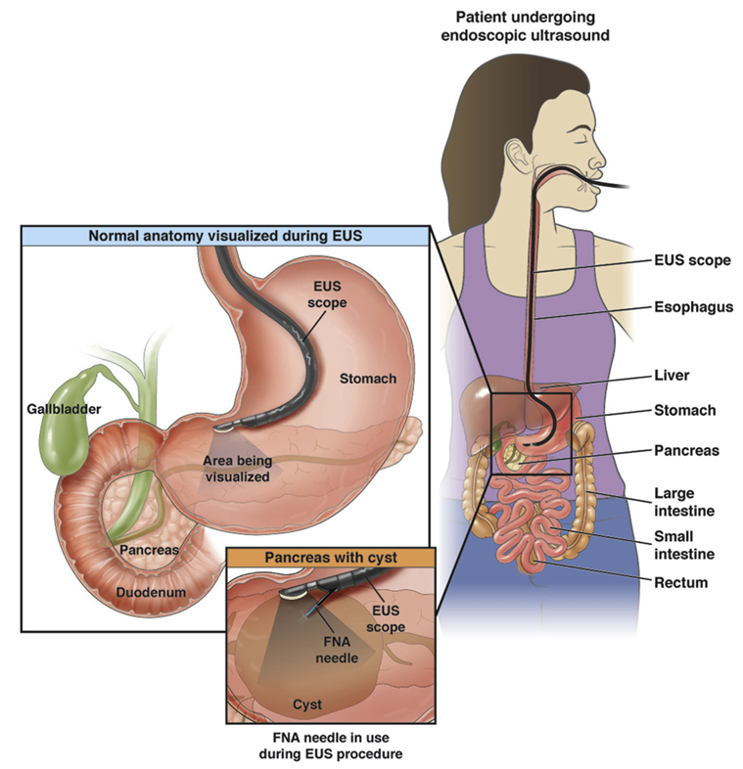
Endoscopic Ultrasound (EUS)
Combines endoscopy and ultrasonography
Allows detailed evaluation of lesions
Fine‑needle aspiration (FNA) and fine‑needle biopsy (FNB) under EUS guidance enable accurate tissue diagnosis
Expanded from a diagnostic tool to therapeutic applications, including drainage of pancreatic fluid collections and biliary interventions.
Recent innovations: EUS‑guided gastroenterostomy, celiac plexus block, and tumour ablation techniques.
Nabi Z, Reddy DN. Digestive and Liver Disease. 2024 Nov 1;56(11):1810-8.
Xu J, Tang X. Frontiers in Medicine. 2025 Jul 4;12:1647463.
https://www.cghjournal.org/article/S1542-3565(19)30411-2/fulltext

Slide 22
Future Directions & Emerging Technologies
🤖
🧬
💊
Robotic Endoscopy
Spatial Transcriptomics
Oral Biologics (FcRn)
Self-propelled colonoscopy robots (Endorobotic, Capso) eliminate patient discomfort; 100% cecal intubation, 0% perforation in 312-patient pilot.
10x Visium mapping of IBD mucosa reveals 47 cell clusters; identifies fibroblast subsets driving stricturing disease — novel therapeutic targets.
Oral anti-TNF antibody fragment (OKT3-FcRn system) achieves therapeutic gut luminal concentrations; Phase 1 safety demonstrated.
🔬
📡
🧠
Organoid-Guided Therapy
Ingestible Sensors
Gut-Brain Axis Targets
Patient-derived colonoids for ex-vivo drug testing; predicts vedolizumab response in UC with 88% accuracy before first infusion.
Vibrant capsule (vibrating motility modulator) FDA-cleared for chronic idiopathic constipation
Vagus nerve stimulation (VNS) reduces Harvey-Bradshaw index by 4.1 points in CD; anti-inflammatory reflex modulation (RESET-CD trial).
Valdastri P. Sci Robot 2024; Corridoni D. Nat Commun 2023; Peyrin-Biroulet L. J Crohns Colitis 2024; Arras L. Gastroenterology 2023; Rao S. Lancet GH 2023; Bonaz B. Gut 2024

Slide 23
Key Take Aways
Gastroenterology is rapidly evolving with integration of advanced diagnostics, therapeutics, AI, and precision medicine.
Rising burden of GI diseases (IBD, CRC, GERD) highlights the need for early diagnosis and minimally invasive management.
Pharmacotherapy advancements (biologics, JAK inhibitors, DAAs) are improving outcomes and enabling personalized treatment approaches.
Breakthroughs in hepatitis therapy have made hepatitis C curable and hepatitis B manageable with long‑term suppression.
Innovations in endoscopic imaging and therapeutic procedures allow accurate diagnosis and minimally invasive treatment.
Emerging technologies like AI, biomarkers, microbiome therapy, and gene editing are shaping the future of gastroenterology.

Slide 24
Thank You!

